Slide 1
Signals and Communication Systems
FM Transmitter and Receiver

Slide 2
FM Transmitters
Session-33

Slide 3
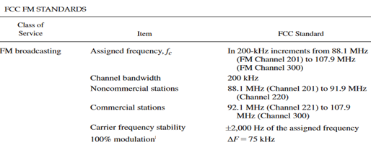
FM Specifications / Standards

Slide 4
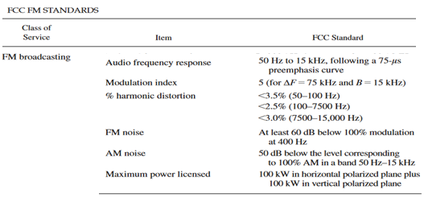
FM Specifications / Standards

Slide 5
FM Transmitter
FM signals have no amplitude variation, therefore FM transmitter can employ class-C throughout even after modulation.
There are two types of FM transmitters.
1. Directly modulated (Variable ReactanceType) FM transmitter 2.Indirectly (phase) modulated FM transmitter.

Slide 6
Block Diagram
PA
Input
∑
VCO
DC Bias
Vcc/2

Slide 7
Directly Modulated FM Transmitter
Direct frequency modulation can be employed using any of the FM circuits. However, direct FM at the final carrier frequency is not feasible because of the problem of maintaining high frequency stability of the carrier while at the same time obtaining adequate frequency deviation.
To solve this problem, indirectly modulated FM transmitters, the frequency modulation is carried out at a lower frequency and with a smaller frequency deviation. Then passing this FM wave through frequency multiplier circuit, the desired carrier frequency and desired frequency is achieved.
With frequency multiplication, the instantaneous frequency is multiplied.
With frequency mixing the deviation is not altered.

Slide 8
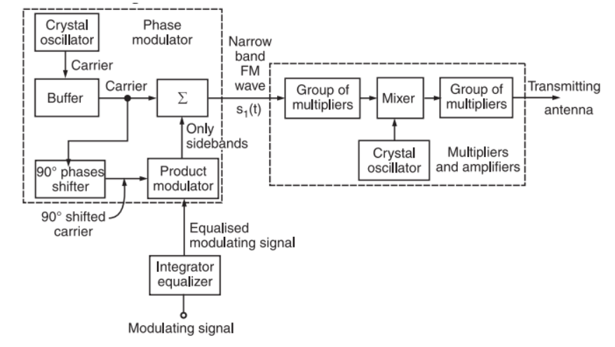
Aemstrong Method

Slide 9
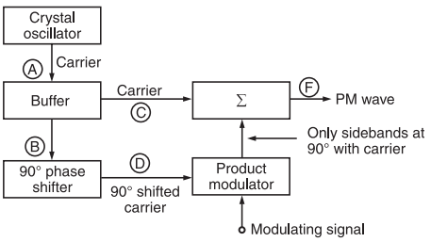
Phase Modulator Circuit

Slide 10
Session-34
FM Receiver

Slide 11
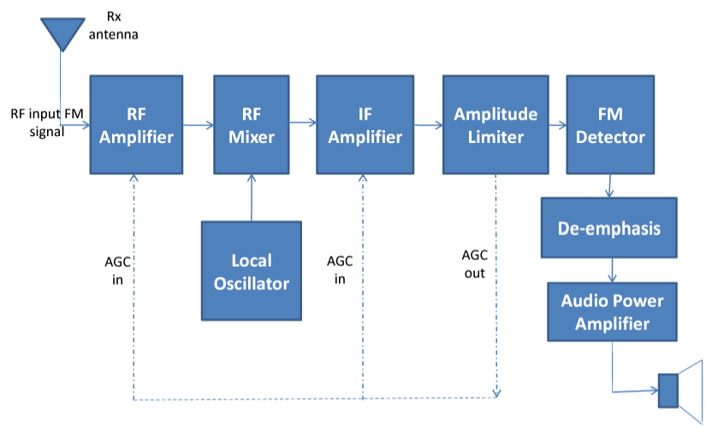
FM Receiver

Slide 12
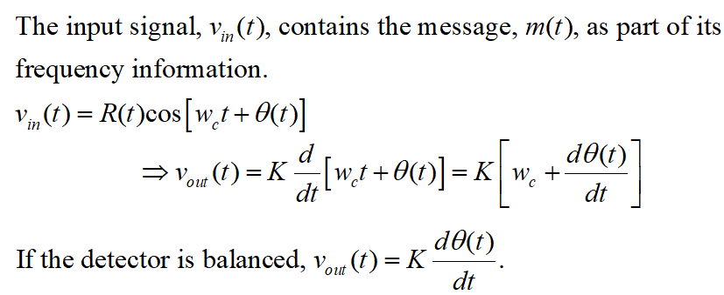
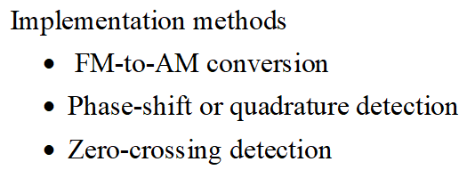
Frequency Modulation Detector

Slide 13
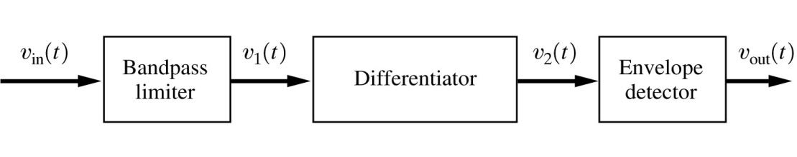
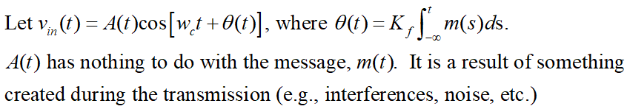
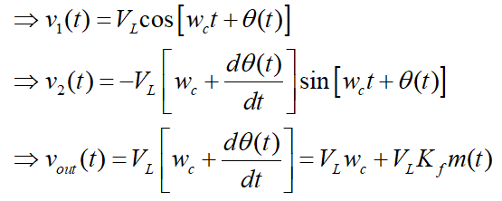
Slope Detector (FM-to AM Conversion)

Slide 14
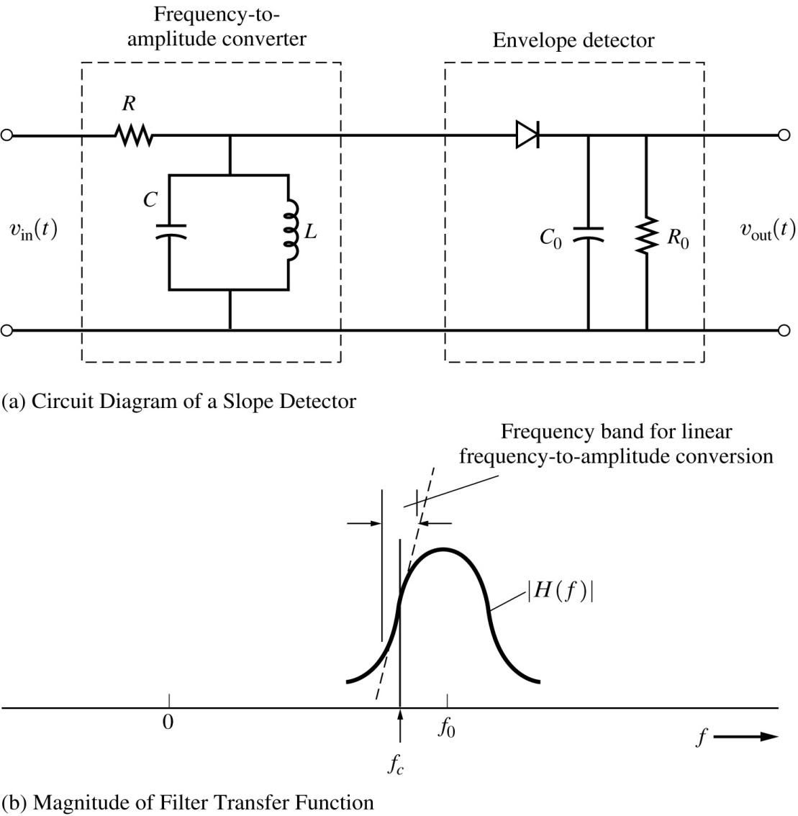
Slope Detector Circuit

Slide 15
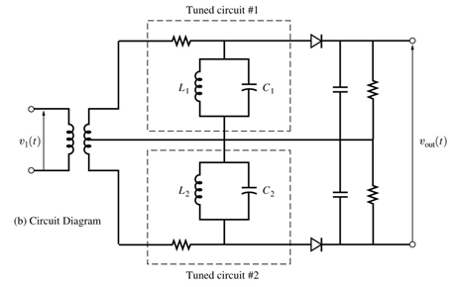
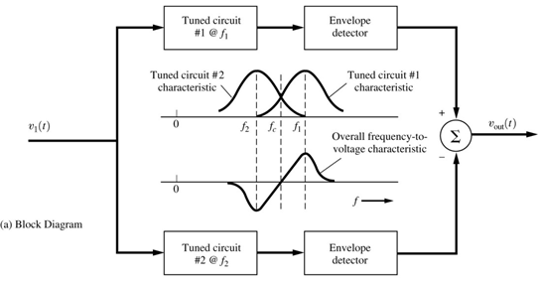
Balanced Discriminator

Slide 16
End

